Slide 1
Revelation 6

Slide 2
Revelation 6: Four Horsemen
“Some claim the four horsemen of the apocalypse can be found in the prophetic book of Ezekiel. A search of the book reveals that horses are mentioned sixteen times in twelve verses in the book but never are they described as “four horses,” nor are they ever described as being of various colors. This is an important point as we will discover when we arrive at the book of Revelation. This means it is an error to claim the four horsemen of the apocalypse are described in the book of Ezekiel.” ¹
LIKE THE MASTER MINISTRIES
Tucson, AZ
Ezekiel 17:15
Ezekiel 23:6
Ezekiel 23:12
Ezekiel 23:20
Ezekiel 23:23
Ezekiel 26:7
Ezekiel 26:10
Ezekiel 26:11
Ezekiel 27:14
Ezekiel 38:4
Ezekiel 38:15 Ezekiel 39:20
¹ https://www.neverthirsty.org/bible-qa/qa-archives/question/four-horses-of-the-apocalypse-represent/
Notes:
Some of Ezekiel may be found in Revelation, but not everything.

Slide 3
Revelation 6:1-2
¹ And I saw when the Lamb opened one of the seals, and I heard, as it were the noise of thunder, one of the four beasts saying, Come and see.
² And I saw, and behold a white horse: and he that sat on him had a bow; and a crown was given unto him: and he went forth conquering, and to conquer.
1
Determination to conquer

Slide 4
Revelation 6:3-4
³ And when he had opened the second seal, I heard the second beast say, Come and see.
⁴ And there went out another horse that was red: and power was given to him that sat thereon to take peace from the earth, and that they should kill one another: and there was given unto him a great sword.
2
Killing; bloodshed

Slide 5
Revelation 6:5-6
⁵ And when he had opened the third seal, I heard the third beast say, Come and see. And I beheld, and lo a black horse; and he that sat on him had a pair of balances in his hand.
⁶ And I heard a voice in the midst of the four beasts say, A measure of wheat for a penny, and three measures of barley for a penny; and see thou hurt not the oil and the wine.
3
Inflation; food = day’s wage
Notes:
(Gr.) “A measure (quart) of wheat for a denarius”
Day’s wage

Slide 6
Revelation 6:7-8
⁷ And when he had opened the fourth seal, I heard the voice of the fourth beast say, Come and see.
⁸ And I looked, and behold a pale horse: and his name that sat on him was Death, and Hell [Hades] followed with him. And power was given unto them over the fourth part of the earth, to kill with sword, and with hunger, and with death ¹, and with the beasts of the earth. ¹
Death by:
Sword; hunger; plague; beasts
4
¹ bublehub.com: “plague” instead of “death”
Notes:
“Beasts” – What does that mean??

Slide 7
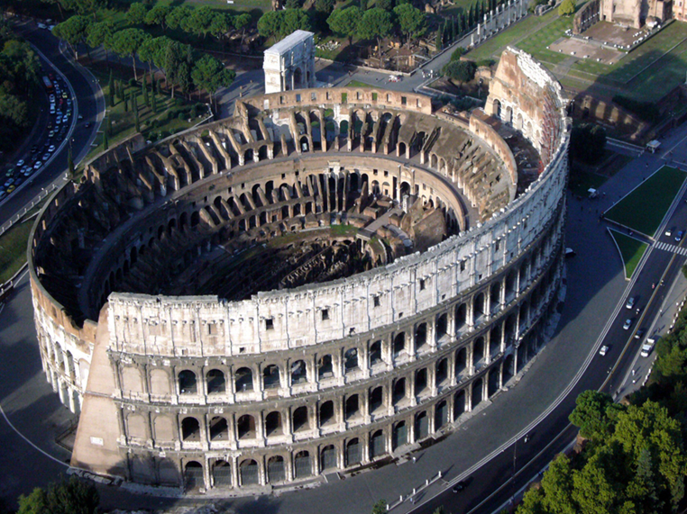
Revelation: “Death by Beasts of Earth”
N
Death by beasts
Notes:
Arch of Constantine (Caesar 306-337 AD) built 315
Revelation 6:8
⁸ And I looked, and behold a pale horse: and his name that sat on him was Death, and Hell [Hades] followed with him. And power was given unto them over the fourth part of the earth, to kill with sword, and with hunger, and with death, and with the beasts of the earth. ¹
Were Saints were forced into the colosseum arena as gladiators by the Caesars?
Historians say Christians may have died in the colosseum in Rome.
But, not specifically targeted for that type of execution.
Does “beast of the earth” in verse 8 indicate otherwise?

Slide 8
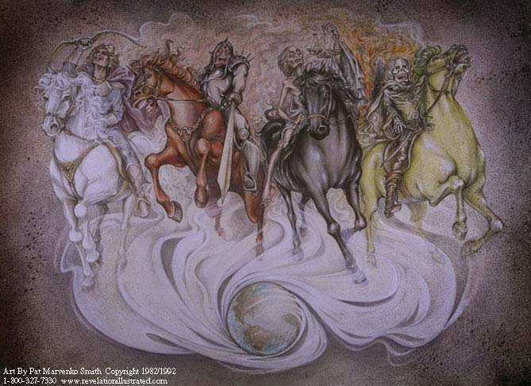
4 Horsemen “Progression”
1
Determination to conquer
2
Killing; bloodshed
3
Inflation; food = day’s wage
Death by:
Sword; hunger; plague; beasts
4
Notes:
First significant symbol we have to interpret.
4 stages of war
Steps to destroy your enemy
Exactly parallels fate of 1st century saints with the Roman Empire
Beasts – Roman colosseum
Hunger & Plague – Chapter 13 being refused commerce
This is the fate of the 1st century church
God is saying, “I know what is happening to you. You just remain faithful. I will take care of it.”

Slide 9
Revelation 6:9-11
⁹ And when he had opened the fifth seal, I saw under the altar the souls of them that were slain for the word of God, and for the testimony which they held:
¹⁰ And they cried with a loud voice, saying, How long, O Lord, holy and true, dost thou not judge and avenge our blood on them that dwell on the earth?
¹¹ And white robes were given unto every one of them; and it was said unto them, that they should rest yet for a little season, until their fellowservants also and their brethren, that should be killed as they were, should be fulfilled.
5
Slain souls under altar

Slide 10
Revelation 6:12-17
¹² And I beheld when he had opened the sixth seal, and, lo, there was a great earthquake; and the sun became black as sackcloth of hair, and the moon became as blood;
¹³ And the stars of heaven fell unto the earth, even as a fig tree casts her untimely figs, when she is shaken of a mighty wind.
¹⁴ And the heaven departed as a scroll when it is rolled together; and every mountain and island were moved out of their places.
¹⁵ And the kings of the earth, and the great men, and the rich men, and the chief captains, and the mighty men, and every bondman, and every free man, hid themselves in the dens and in the rocks of the mountains;
¹⁶ And said to the mountains and rocks, Fall on us, and hide us from the face of him that sits on the throne, and from the wrath of the Lamb:
¹⁷ For the great day of his wrath is come; and who shall be able to stand?
6
Evil receives God’s wrath

Slide 11
Revelation 6
1
Determination to conquer
2
Killing; bloodshed
3
Inflation; food = day’s wage
4
Death by:
Sword; hunger; plague; beasts
5
Slain souls under altar
6
Evil receives God’s wrath
Notes:
What is Chapter 6?
Seeing the anatomy of a judgment
Table of Contents for Revelation
Summary of what is occurring or what is about to occur
God’s opening statement as he lays out his case against villain of Revelation
We are given hints and clues as to the villain’s identity as Revelation unfolds

Slide 12
Revelation: Response to Tribulation
Per Chapter
1: Characteristics
2: 7 Churches Involved
3: n / a
4: n / a
5: n / a
6: Characteristics
7: Characteristics
8: Villain Won’t Repent
9: Villain Won’t Repent
10: God Has Had Enough
11: History of Tribulation
12: History of Tribulation
13: History of Tribulation
14: Heaven Rejoices
15: Heaven Rejoices
16: Judgment of Villain
17: Villain Identified
18: Accomplices Listed
19: Saints’ Victory
20: Characteristics
21: Rewards of Faithful
22: Rewards of Faithful
Notes:
How do you determine what Revelation’s Tribulation actually is?
How do you determine the identity of Revelation’s villain?
How do you determine why John wept in chapter 5?
How do you determine the purpose and use of the scroll with 7 seals?
The answers are in the “Forbidden Zone”
Revelation is laid out in story, but it is not actually a story per sei
God is laying out his case against the villain of Revelation
This is the anatomy of God’s judgment against evil, not just the villain of Revelation!
Chapter 6 = Opening Statement (Table of Contents)

